Slide 1

Pixels
Iteration 2
Leader: Austin Cullar
Members: Kem Andrew, Taylor Murphy

Slide 2
Summary
Our project takes a series of images from an experimental test and converts them to binary black and white images for analysis
Using the difference between each subsequent image our program will be able determine values i.e.(dispersant speed, drop volume) critical to learning how best to extract underground oils lock inside porous structures in the ground

Slide 3
Functional requirements
R1: The system must convert a set of color images into binary images
R2: The system must store and tag each new binary image for troubleshooting purposes
R3: The system must count the up number of each pixel for each individual image and store the data for later use
R4: The system must graph the gathered data for user analysis
R5: The system must allow for repeatability such that multiple sets of data can be processed in sequence without time consuming GUI navigation

Slide 4
Non Functional Requirements
R1: The system must be able to process many sets of images relevant to a specific surfactant or dispersant
R2: The system must accurately convert color images to binary images such that the difference between flow and non flow areas are obvious
R3: The system must be a self contained executable program that is well documented and intuitive enough for use by individuals without a Computer Science background

Slide 5
Use Case Diagram

Slide 6
Expanded use case
User | System
1. TUCBW User specifies file names | 2. System saves folder names (‘image’ folder, and ‘result’ folder) for future data preservation.
3. User pressing ‘run’ on the GUI | 4. System processes all images in the specified image folder, resulting in a list of binary images which will be saved in the ‘result’ folder the user previously specified.
 | 5. The resulting binary images are then processed to construct a table of data showing the amount of black and white pixels for each image.
 | 6. A graph is then created from the generated data, which will be displayed on the User’s screen.
7. TUCEW the user has the choice to save the graph and/or data, or print the graph/data. | 8. Depending on what the user selects, the system will either create a file in which the graph/data will be saved, or printed

Slide 7
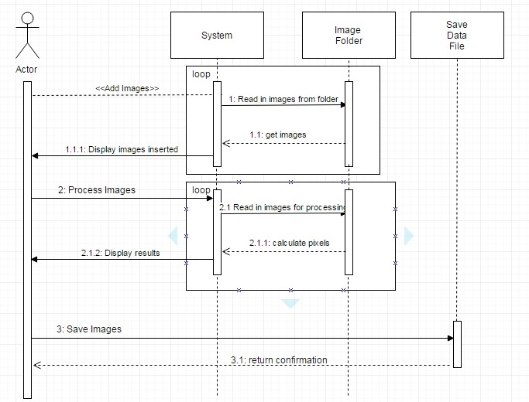
Sequence Diagrams

Slide 8
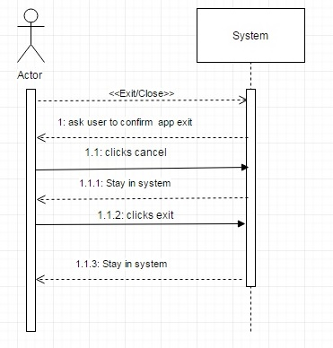
Sequence Diagrams

Slide 9
Domain Model

Slide 10
Architectural Model

Slide 11
Team Member Work Accomplished
Taylor: Videos, Functional Requirements, Non Functional Requirements, Analysis code
Kem: Videos, Sequence Diagrams, Domain Model, Architectural Model, GUI Code
Austin: Use Case Diagrams, Expanded Use Case, Analysis code

Slide 12
Schedule
Primary Goals
Thresholding adjustments
Determining what type of graph the customer will need
Creating functionality for storing and printing said graphs
Future Goals
Track the location of the drop as it falls from the injection needle, by following its shape changeable centroid.
Obtain drop volume based on its lateral size and kinematic quantities such as positon, velocity, acceleration.

Slide 13
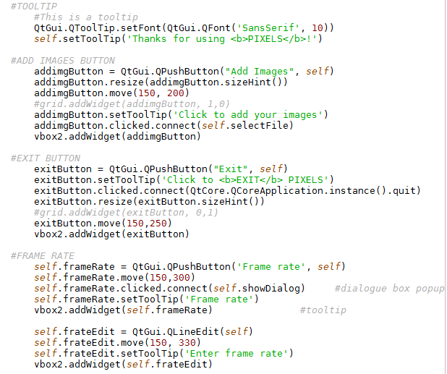


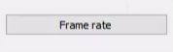
Gui

Slide 14
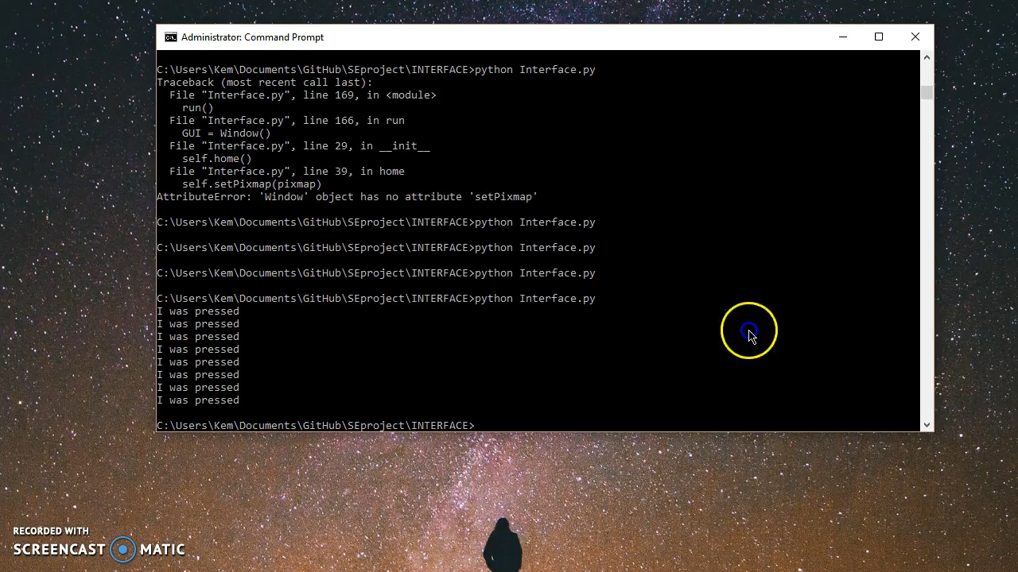

Slide 15
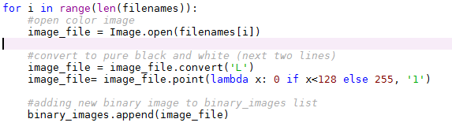

Conversion Threshold

Slide 16
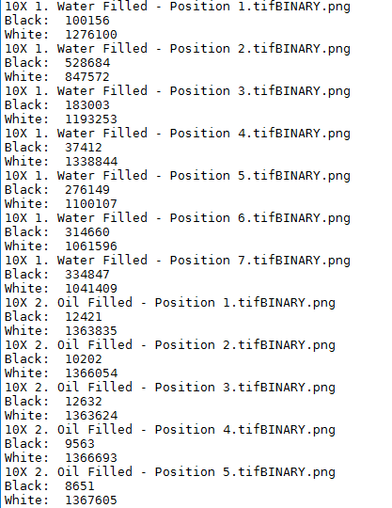
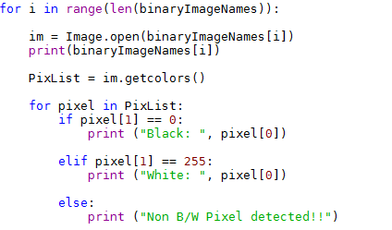
Pixel Counting

Slide 17
